Slide 1
COSE472(00): Information Retrieval (정보검색) Lecture 4. Evaluation
Instructor: Jaegul Choo (주재걸)
jchoo@korea.ac.kr

Slide 2
Recap of the Last Lecture
Term-document matrix
Bag-of-words model
Log-frequency weighting on tf
Inverse document frequency weighting
Document as vectors (vector space model)
Cosine similarity
Vector space ranking using cosine similarity

Slide 3
Today’s Topic: Evaluation
How can we evaluate search results?
Two approaches
Rank-independent evaluation (binary evaluation)
Rank-dependent evaluation
Notes:
careses
parties
separational -> separate
factional -> faction

Slide 4
Measures for a Search Engine
How fast does it index?
Number of documents / hour
How fast does it search?
Latency as a function of index size
How frequent is the index refreshed
Recency issues → Twitter
Expressiveness of query language
Ability to express complex information needs
Speed on complex queries
Notes:
careses
parties
separational -> separate
factional -> faction

Slide 5
Evaluating an IR System
Note: the information need is translated into a query
Relevance is assessed relative to the information need not the query
e.g., Information need: I'm looking for information on whether drinking red wine is more effective at reducing your risk of heart attacks than white wine.
Query: wine red white heart attack effective
Evaluate whether the document addresses the information need, not whether it has these words
Relevance measurement requires three elements:
A benchmark document collection
A benchmark suite of queries
A binary assessment of either Relevance or Irrelevance for ach query-doc pair
Notes:
careses
parties
separational -> separate
factional -> faction

Slide 6
Standard Relevance Benchmarks
TREC (Text REtrieval Conference)
A large IR testbed by National Institute of Standards and Technology (NIST)
“Retrieval tasks” specified
Human experts mark, for each query and for each doc, Relevant or Nonrelevant
Or at least for subset of docs that some system returned for that query

Slide 7
Binary Evaluation: Precision and Recall
Documents labeled as relevant or not relevant with respect to a query; For any fixed result set (retrieved documents) of labeled documents:
Precision: fraction of retrieved docs that are relevant
= P(relevant|retrieved)
Recall: fraction of relevant docs that are retrieved
= P(retrieved|relevant)

Slide 8
Confusion Matrix
True positive (tp): Retrieved (predicted as relevant) and indeed relevant
True negative (tn): Not Retrieved (predicted as nonrelevant) and indeed nonrelevant
False positive (fp): Retrieved (predicted as relevant), but in fact nonrelevant
False negative (fn): Not Retrieved (predicted as nonrelevant), but in fact relevant
 | Relevant | Nonrelevant
Retrieved | tp | fp
Not Retrieved | fn | tn

Slide 9
Precision
Precision P = tp / (tp + fp)
 | Relevant | Nonrelevant
Retrieved | tp | fp
Not Retrieved | fn | tn

Slide 10
Recall
Precision P = tp / (tp + fp)
Recall R = tp / (tp + fn)
 | Relevant | Nonrelevant
Retrieved | tp | fp
Not Retrieved | fn | tn

Slide 11
Accuracy
Precision P = tp / (tp + fp)
Recall R = tp / (tp + fn)
Accuracy = (tp + tn) / (tp + fp + fn + tn)
 | Relevant | Nonrelevant
Retrieved | tp | fp
Not Retrieved | fn | tn

Slide 12
Confusion Matrix: Example
 | Relevant | Nonrelevant
Retrieved | 81 | 252
Not Retrieved | 23 | 9644
What is Precision?
What is Recall?
What is Accuracy?

Slide 13
Should we instead use the accuracy measure for evaluation?
Given a query an engine classifies each doc as "Relevant" or "Irrelevant".
The accuracy of an engine: the fraction of these classifications that are correct.
Accuracy is a commonly used evaluation measure in machine learning classification work.
Why is this not a very useful evaluation measure in IR?

Slide 14
Why not just use accuracy?
How to build a 99.9999% accurate search engine on a low budget….
Accuracy is improved!
Snoogle.com
Search for:
0 matching results found.
 | Relevant | Nonrelevant
Retrieved | 81 | 252
Not Retrieved | 23 | 9644
 | Relevant | Nonrelevant
Retrieved | 0 | 0
Not Retrieved | 104 | 9896

Slide 15
Precision-Recall Tradeoff
You can increase recall by returning more docs.
Recall is a non-decreasing function of the number of docs retrieved.
A system that returns all docs has 100% recall!
The converse is also true (usually): It’s easy to get high precision for very low recall when a small number of docs are retrieved.
Notes:
careses
parties
separational -> separate
factional -> faction

Slide 16
A Combined Measure: F_{ᵝ}
Combined measure that assesses this tradeoff is F_{ᵝ} measure (weighted harmonic mean):
where β ² = (1 - α) / α
People usually use balanced F₁ measure:
i.e., with β = 1 or α = ½
F_{ᵝ} measures the effectiveness of retrieval with respect to a user who attaches β times as much importance to recall as precision.
Harmonic mean is a conservative average.
Notes:
careses
parties
separational -> separate
factional -> faction

Slide 17
F_{ᵝ} : Example
 | Relevant | Nonrelevant
Retrieved | 18 | 2
Not Retrieved | 82 | 1,000,000,000
Precision = 18 / (18+2) = 0.9
Recall = 18 / (18+82) = 0.18
F₁ = 2*(Precision) / (Precision+Recall)
= 2*0.9*0.18 / (0.9 + 0.18) = 0.3
F₁ is a lot lower than the mean (0.9 + 0.18) / 2 = 0.54
Number of true negatives is not factored in:
The F₁ result will be the same for 1000 true negatives (instead of 1,000,000,000).
Notes:
careses
parties
separational -> separate
factional -> faction

Slide 18
F_{ᵝ} : Why Harmonic Mean?
The simple (arithmetic) mean is 50% for “snoogle”, which is too high.
Main idea: Punish really bad performance on one of precision/recall.
Notes:
careses
parties
separational -> separate
factional -> faction

Slide 19
Evaluating Ranked Results
Search engine returns ranked list of documents
Take first document, interpret as unordered set of size 1, compute unordered evaluation measures for this set.
Take top 2 documents, interpret as unordered set of size 2, compute unordered evaluation measures for this set.
Take top 3 documents, interpret as unordered set of size 3, compute unordered evaluation measure for this set.
...
Plot individual measures → precision-recall curve
Or : Combine individual measures into one.
Notes:
careses
parties
separational -> separate
factional -> faction

Slide 20
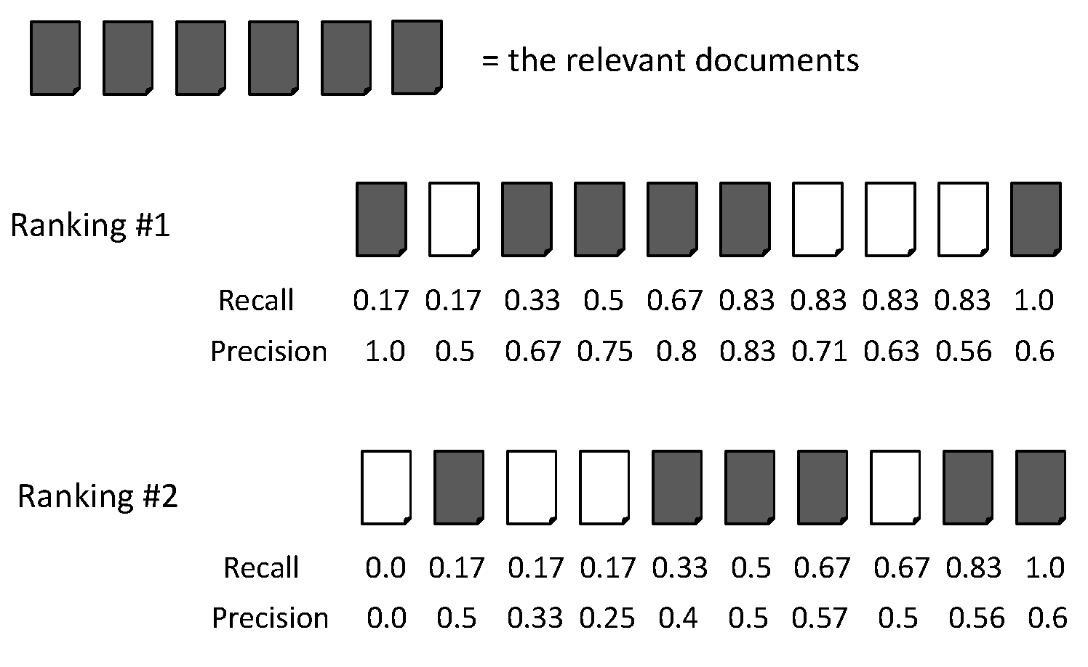




Evaluating Ranked Results: Example
Top 10 documents of two different rankings together with the recall and precision values calculated at every rank position for a query with 6 relevant documents
Notes:
careses
parties
separational -> separate
factional -> faction

Slide 21
Evaluating Ranked Results: Example
At rank position 10, the two rankings have same effectiveness
Recall 1.0, precision 0.6
At higher rank positions, the first ranking is better
e.g., at rank position 4, the first ranking has 0.5 recall and 0.75 precision, the second ranking has 0.17 recall and 0.25 precision
Notes:
careses
parties
separational -> separate
factional -> faction

Slide 22
Summarizing Ranking Evaluation
Method 1
Calculating recall and precision at fixed rank positions
Method 2
Calculating precision at standard recall levels, from 0.0 to 1.0 in increments of 0.1. Each ranking then is represented using 11 numbers.
requires interpolation (refers to any technique for calculating a new point between two existing data points, 보간법)
Generate recall-precision graph
Method 3
Averaging the precision values from the rank positions where a relevant document was retrieved
Average precision (평균 정확률)
Notes:
careses
parties
separational -> separate
factional -> faction

Slide 23
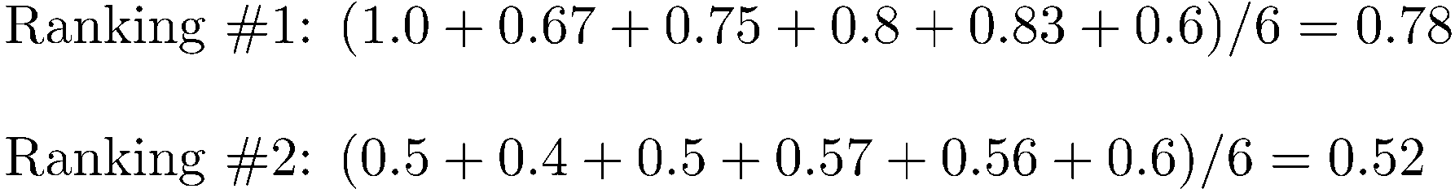
Average Precision: Example
Notes:
careses
parties
separational -> separate
factional -> faction

Slide 24
Average Precision
It is single number based on the ranking of all the relevant documents (적합한 문서들의 순위에 근거한).
The value depends heavily on the highly ranked relevant documents.
It is an appropriate measure for evaluating the task of finding as many relevant documents as possible while reflecting the intuition that top-ranked documents are the most important.
We need a method of calculating the average effectiveness for the entire set of queries → MAP.
Notes:
careses
parties
separational -> separate
factional -> faction

Slide 25
Mean Average Precision (MAP)
Mean Average Precision (MAP)
summarize rankings from multiple queries by averaging average precision (평균 정확률을 모든 질의에 대하여 평균을 구함)
most commonly used measure in research papers
assumes user is interested in finding many relevant documents for each query
requires many relevance judgments in text collection
Precision-Recall graph is also useful summaries.
Although MAP is useful, sometimes too much information is lost.
Notes:
careses
parties
separational -> separate
factional -> faction

Slide 26
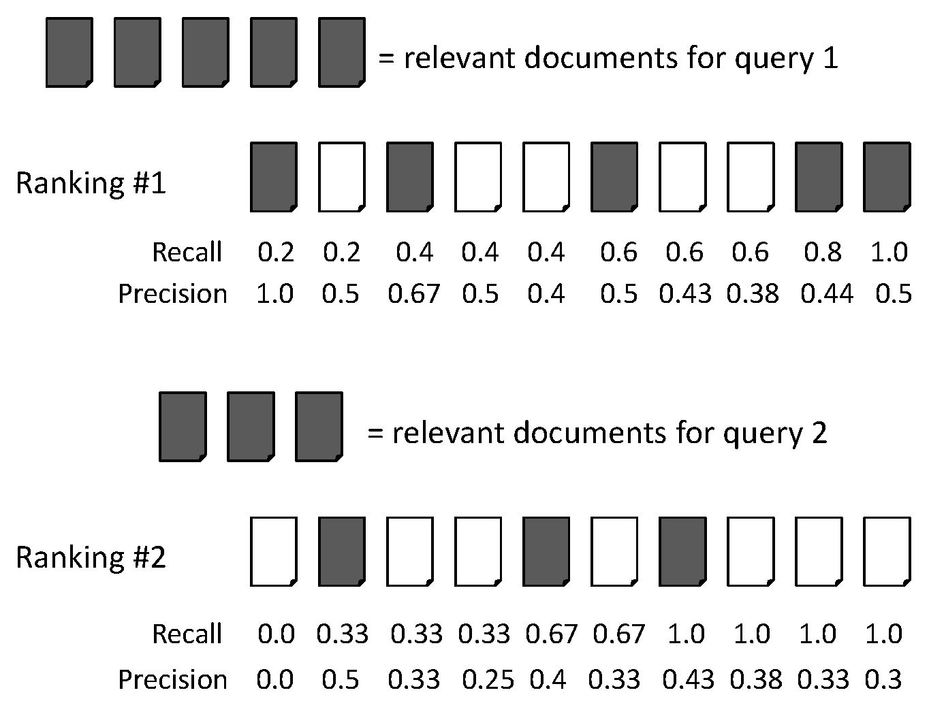
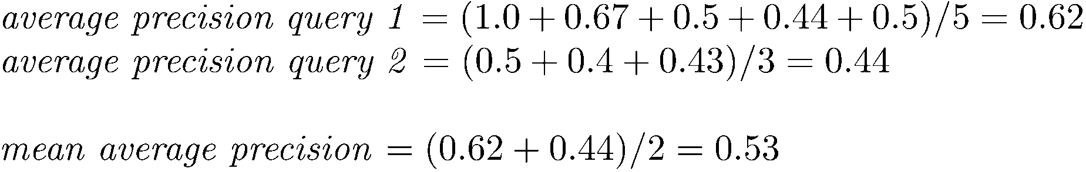
Mean Average Precision (MAP): Example
Notes:
careses
parties
separational -> separate
factional -> faction

Slide 27
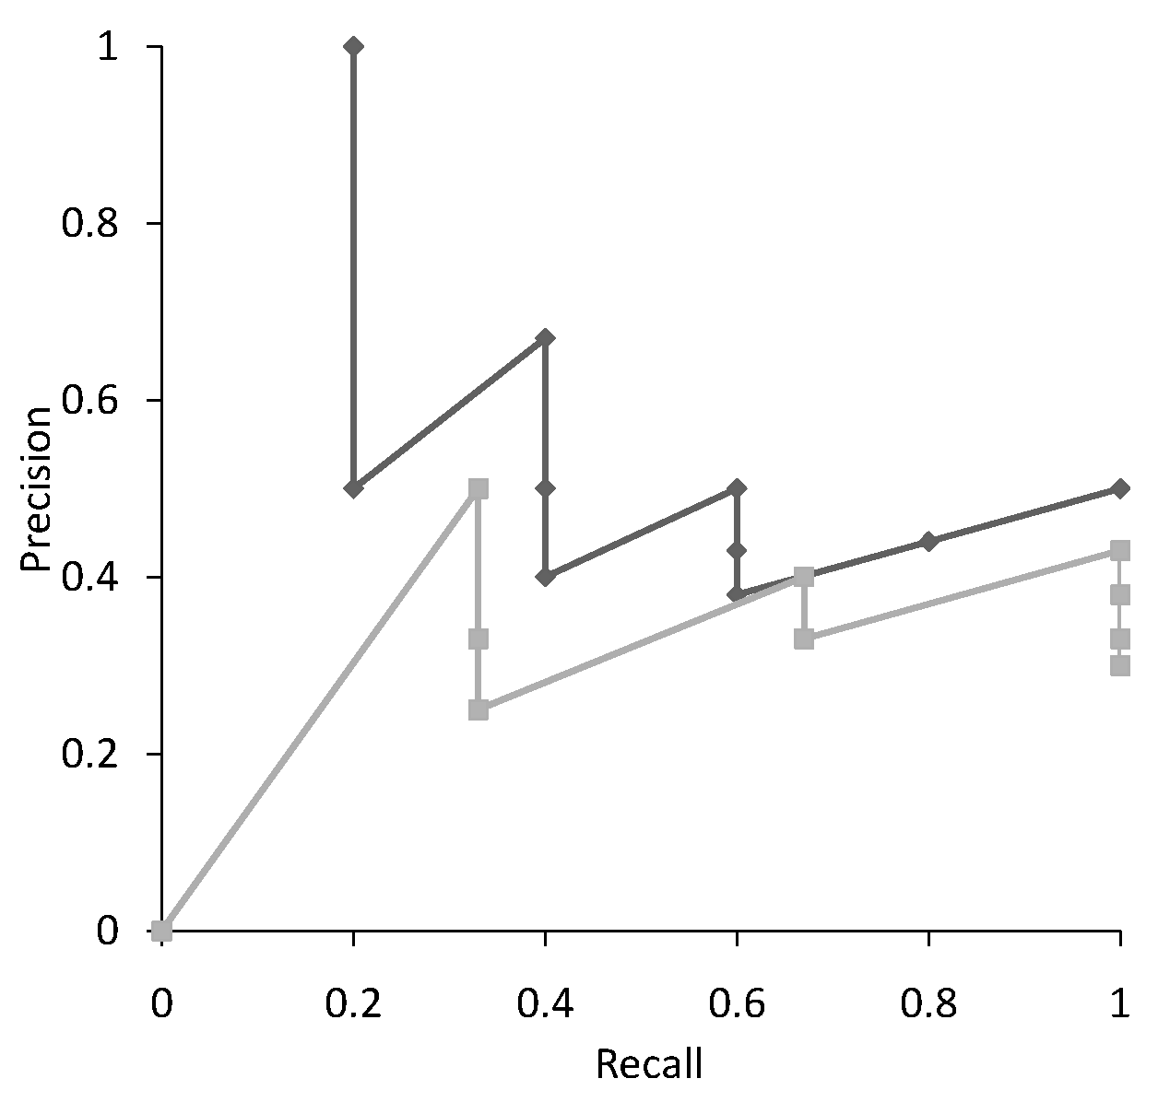
Precision Recall Curve
Notes:
careses
parties
separational -> separate
factional -> faction

Slide 28
Interpolation
Why we need interpolation:
We want to calculate precision at standard recall levels, from 0.0 to 1.0 in increments of 0.1.
However, we do not have the exact value for these recall levels.
How we do interpolation:
Defines precision at any recall level as the maximum precision observed in any recall-precision point at a higher recall level (재현율 수준에 따른 정확도를 정의하는데 만일 더 높은 재현율 수준에서의 관찰된 정확도가 현재의 정확도보다 높다면 더 높은 정확도를 현재의 정확도로 정의한다)
produces a step function
defines precision at recall 0.0
Notes:
careses
parties
separational -> separate
factional -> faction

Slide 29
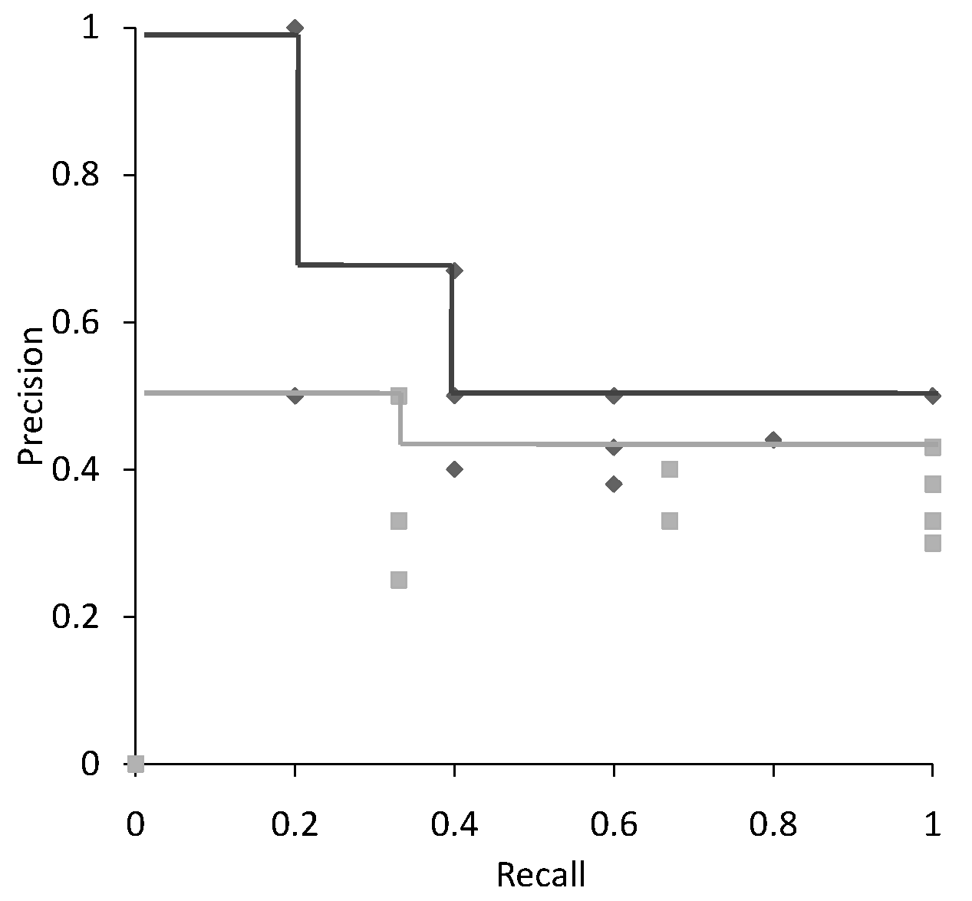
Interpolation: Example
Notes:
careses
parties
separational -> separate
factional -> faction

Slide 30
Precision Recall Curve
Notes:
careses
parties
separational -> separate
factional -> faction

Slide 31
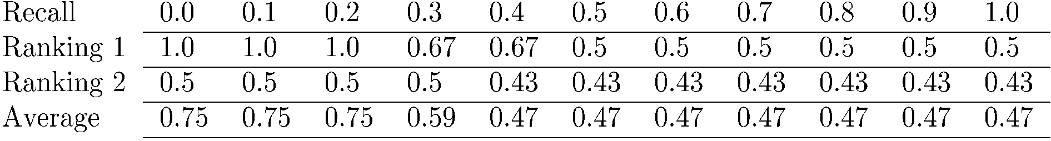
Average Precision at Standard Recall Levels
Averaging between two different queries
Precision-recall curve plotted by simply joining the average precision points at the standard recall levels.
Notes:
careses
parties
separational -> separate
factional -> faction

Slide 32
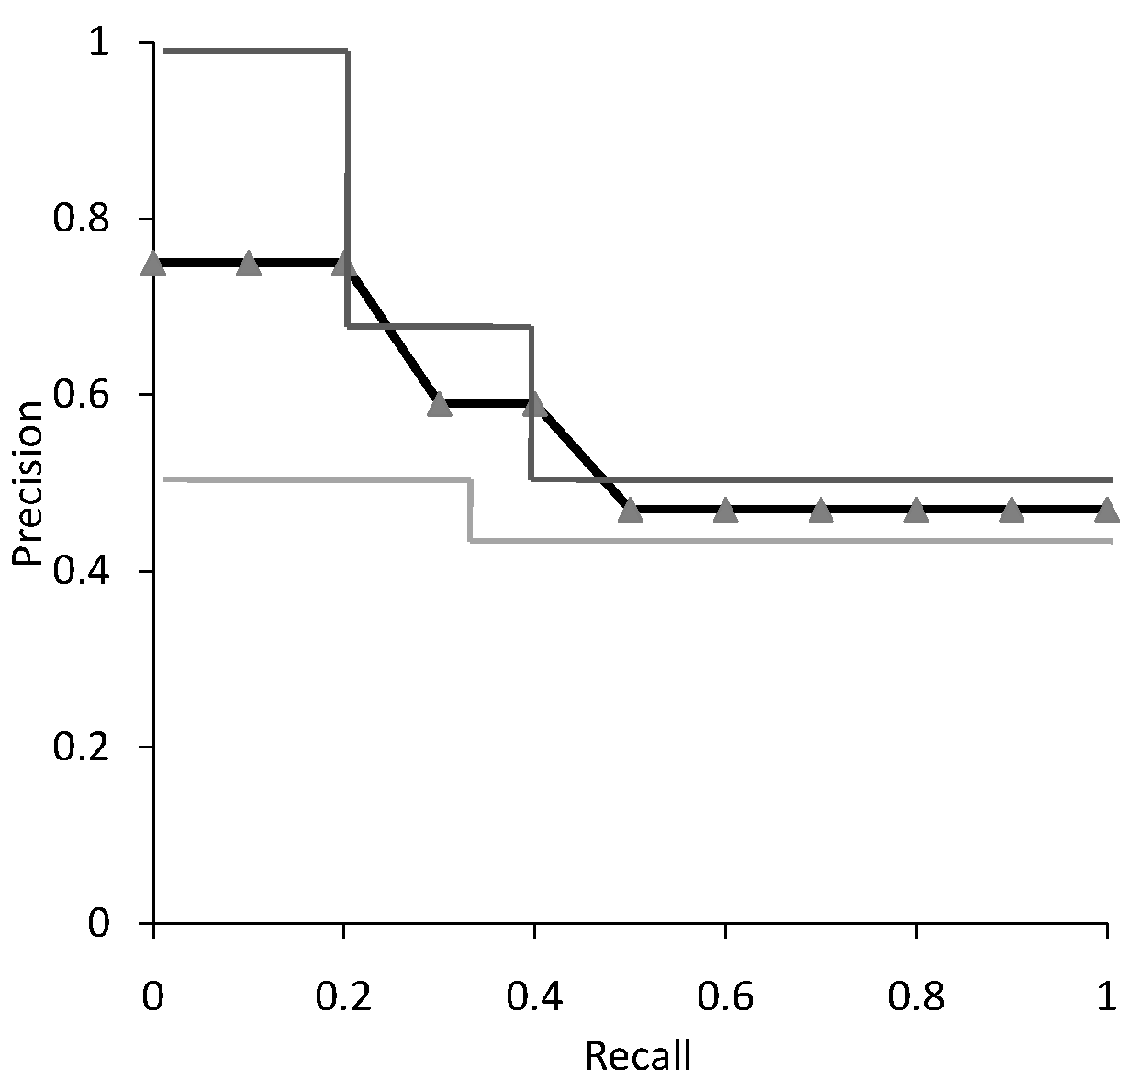
Average Precision-Recall Curve
Averaging between two different queries (from the previous slide)
Notes:
careses
parties
separational -> separate
factional -> faction

Slide 33
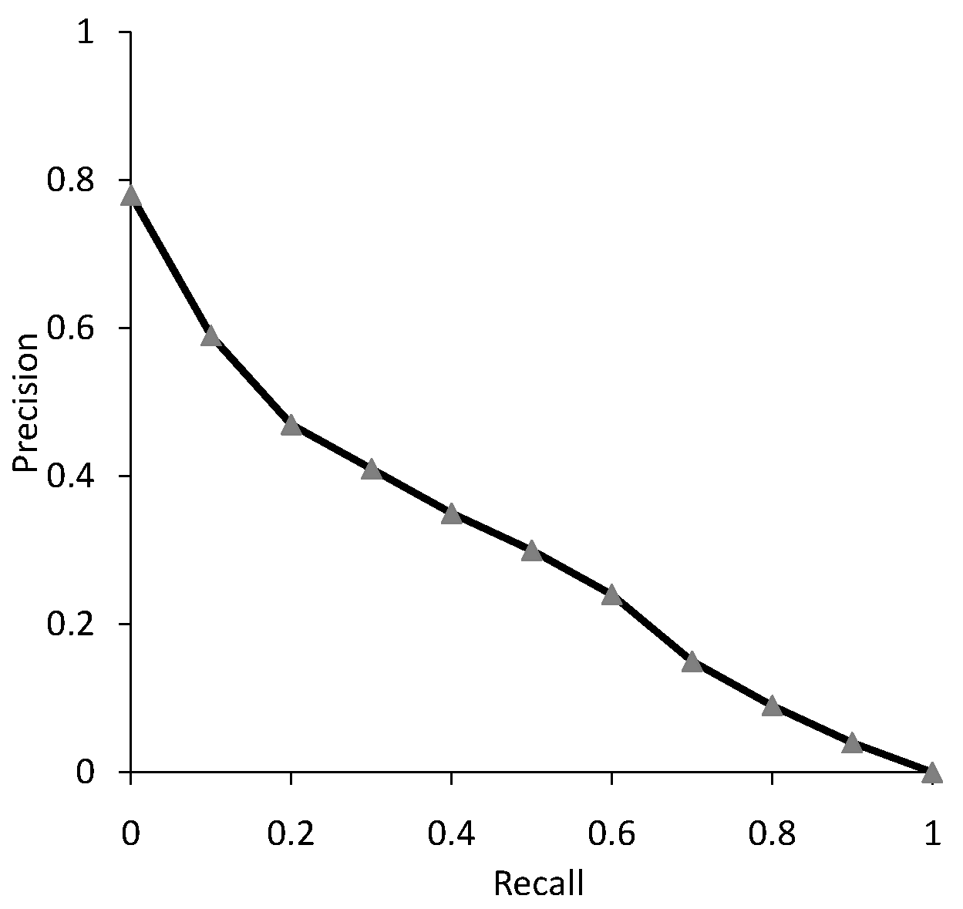
Average Precision-Recall Curve from 50 Queries
Notes:
careses
parties
separational -> separate
factional -> faction

Slide 34
Focusing on Top Documents
Users tend to look at only the top part of the ranked result list to find relevant documents.
Some search tasks have only one relevant document (첫번째 검색결과만)
Navigational search, e.g., querying ‘youtube’ for finding a particular website
Question answering
Recall is not appropriate.
Instead, we need to measure how well the search engine does at retrieving relevant documents at very high ranks.
Notes:
careses
parties
separational -> separate
factional -> faction

Slide 35
Focusing on Top Documents: Methods
Precision at Rank R (R번째 순위에서의 정확도)
R is typically set as 5, 10, or 20.
Easy to compute, average, and understand
Not sensitive to rank positions less than R
Reciprocal Rank (역순위)
Reciprocal (역수) of the rank at which the first relevant document is retrieved.
e.g., 1st rank → 1/1, 3rd rank → 1/3.
Mean Reciprocal Rank (MRR) (평균역순위) is the average of the reciprocal ranks over a set of queries.
Very sensitive to the rank position of the first relevant document.
Notes:
careses
parties
separational -> separate
factional -> faction

Slide 36
Discounted Cumulative Gain (DCG)
Popular measure for evaluating web search and related tasks.
Two assumptions:
Highly relevant documents are more useful than marginally relevant document (매우 적합한 문서가 조금 적합한 문서보다 유용하다.)
The lower the ranked position of a relevant document is, the less useful it is for the user, since it is less likely to be examined.
Notes:
careses
parties
separational -> separate
factional -> faction

Slide 37
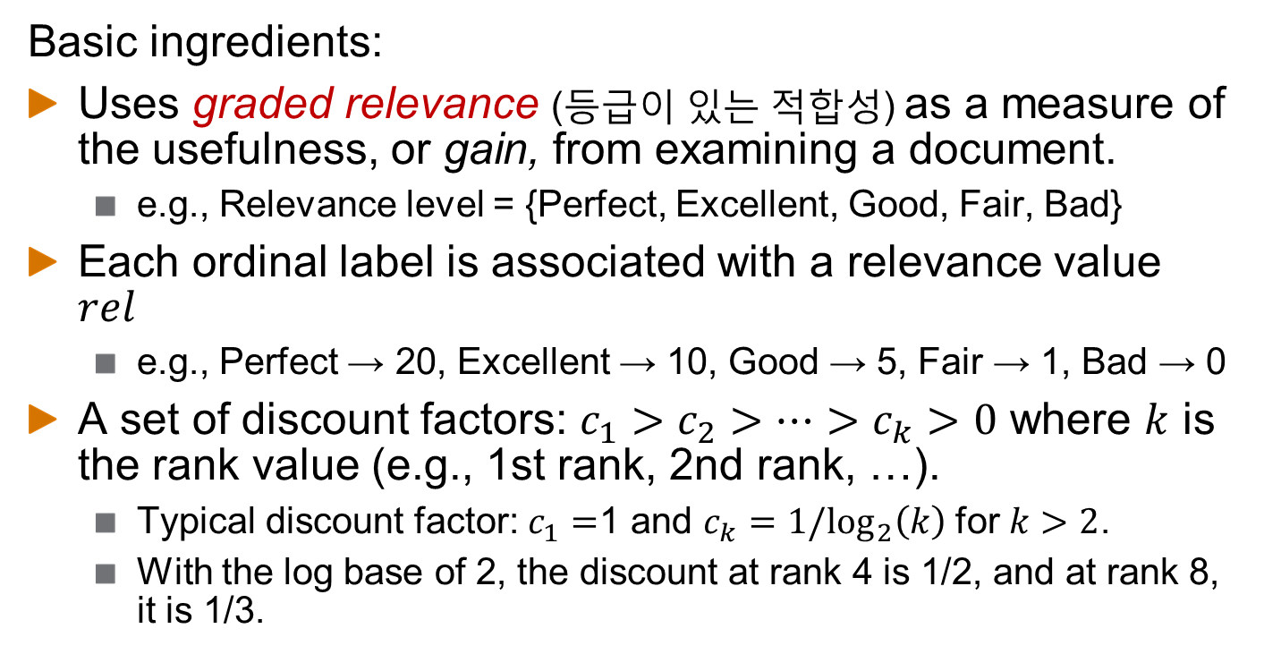
Discounted Cumulative Gain (DCG)
Basic ingredients:
Uses graded relevance (등급이 있는 적합성) as a measure of the usefulness, or gain, from examining a document.
e.g., Relevance level = {Perfect, Excellent, Good, Fair, Bad}
Each ordinal label is associated with a relevance value $rel$
e.g., Perfect → 20, Excellent → 10, Good → 5, Fair → 1, Bad → 0
A set of discount factors: $c_{1}>c_{2}>…>c_{k}>0$ where $k$ is the rank value (e.g., 1st rank, 2nd rank, …).
Typical discount factor: $c_{1}=$1 and $c_{k}=1/\log_{2}\left(k\right)$ for $k>2$.
With the log base of 2, the discount at rank 4 is 1/2, and at rank 8, it is 1/3.
Notes:
careses
parties
separational -> separate
factional -> faction

Slide 38
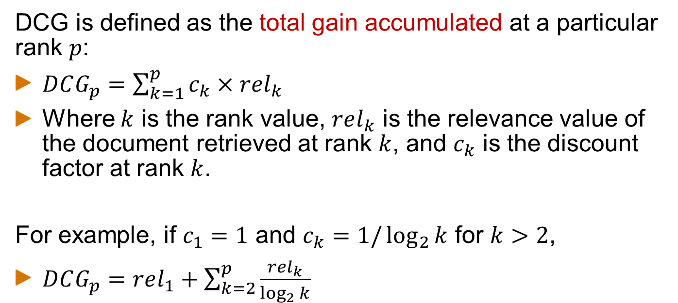
Discounted Cumulative Gain (DCG)
DCG is defined as the total gain accumulated at a particular rank $p$:
$DCG_{p}=\sum_{k=1}^{p}{c_{k}×rel_{k}}$
Where $k$ is the rank value, $rel_{k}$ is the relevance value of the document retrieved at rank $k$, and $c_{k}$ is the discount factor at rank $k$.
For example, if $c_{1}=1$ and $c_{k}=1/\log_{2}{k}$ for $k>2$,
$DCG_{p}=rel_{1}+\sum_{k=2}^{p}{\frac{rel_{k}}{\log_{2}{k}}}$
Notes:
careses
parties
separational -> separate
factional -> faction

Slide 39
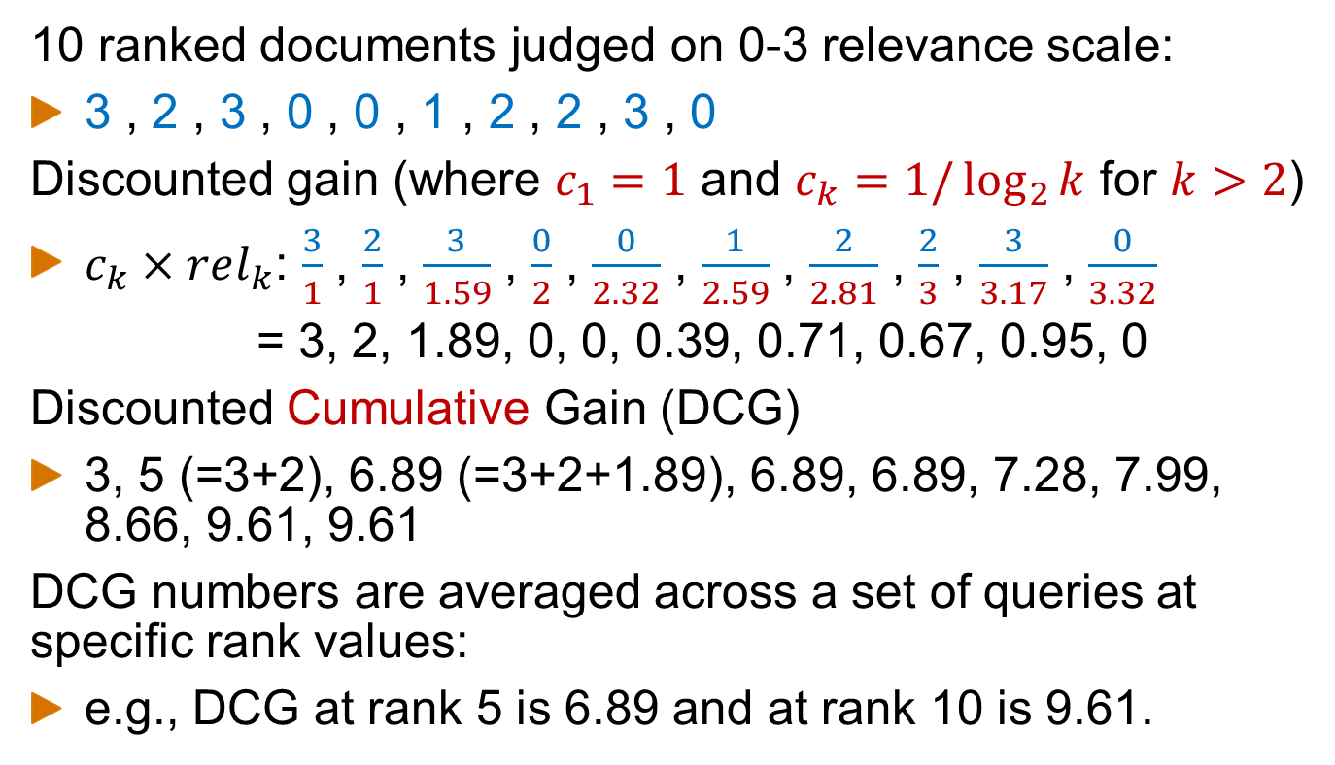
DCG Example
10 ranked documents judged on 0-3 relevance scale:
3 , 2 , 3 , 0 , 0 , 1 , 2 , 2 , 3 , 0
Discounted gain (where $c_{1}=1$ and $c_{k}=1/\log_{2}{k}$ for $k>2$)
$c_{k}×rel_{k}$: $\frac{3}{1}$ , $\frac{2}{1}$ , $\frac{3}{1.59}$ , $\frac{0}{2}$ , $\frac{0}{2.32}$ , $\frac{1}{2.59}$ , $\frac{2}{2.81}$ , $\frac{2}{3}$ , $\frac{3}{3.17}$ , $\frac{0}{3.32}$
= 3, 2, 1.89, 0, 0, 0.39, 0.71, 0.67, 0.95, 0
Discounted Cumulative Gain (DCG)
3, 5 (=3+2), 6.89 (=3+2+1.89), 6.89, 6.89, 7.28, 7.99, 8.66, 9.61, 9.61
DCG numbers are averaged across a set of queries at specific rank values:
e.g., DCG at rank 5 is 6.89 and at rank 10 is 9.61.
Notes:
careses
parties
separational -> separate
factional -> faction

Slide 40
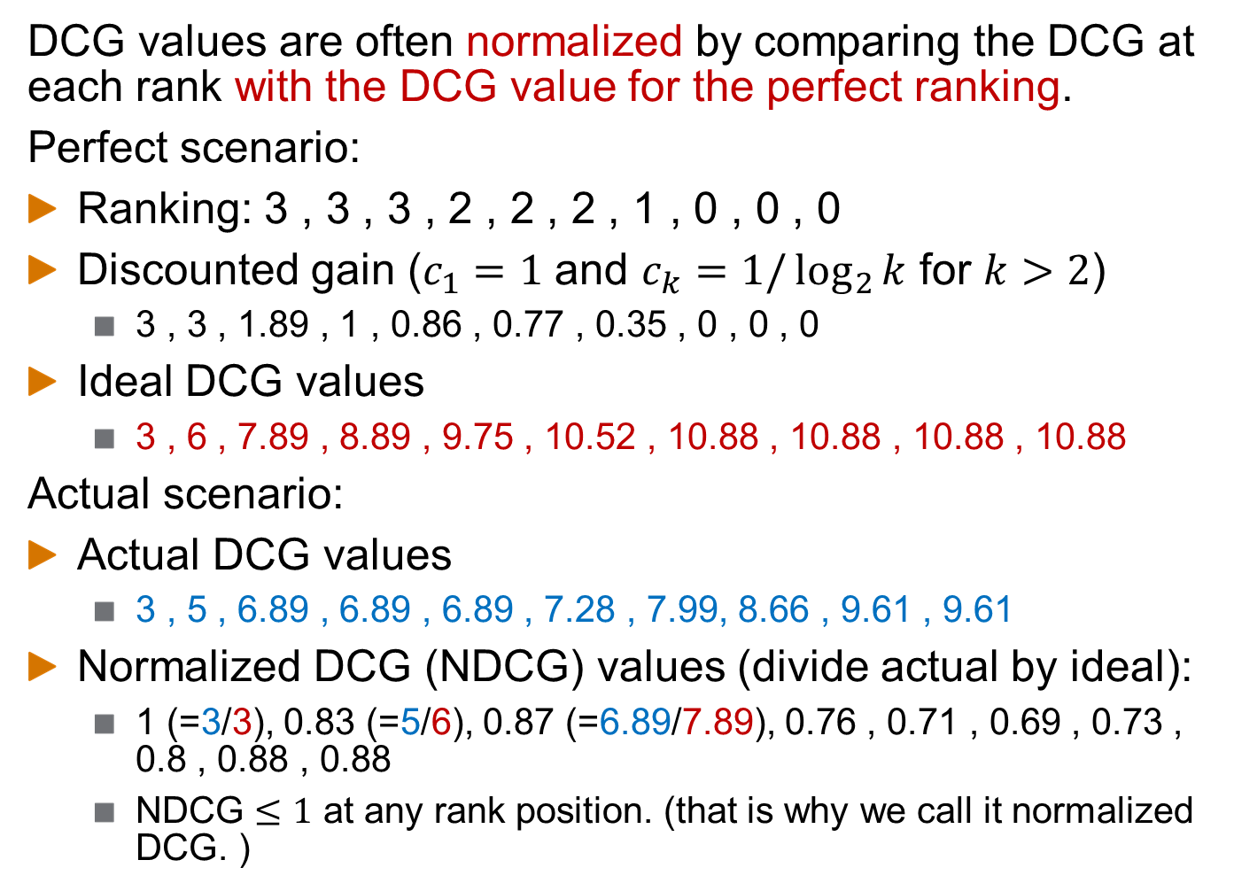
Normalized DCG (NDCG)
DCG values are often normalized by comparing the DCG at each rank with the DCG value for the perfect ranking.
Perfect scenario:
Ranking: 3 , 3 , 3 , 2 , 2 , 2 , 1 , 0 , 0 , 0
Discounted gain ($c_{1}=1$ and $c_{k}=1/\log_{2}{k}$ for $k>2$)
3 , 3 , 1.89 , 1 , 0.86 , 0.77 , 0.35 , 0 , 0 , 0
Ideal DCG values
3 , 6 , 7.89 , 8.89 , 9.75 , 10.52 , 10.88 , 10.88 , 10.88 , 10.88
Actual scenario:
Actual DCG values
3 , 5 , 6.89 , 6.89 , 6.89 , 7.28 , 7.99, 8.66 , 9.61 , 9.61
Normalized DCG (NDCG) values (divide actual by ideal):
1 (=3/3), 0.83 (=5/6), 0.87 (=6.89/7.89), 0.76 , 0.71 , 0.69 , 0.73 , 0.8 , 0.88 , 0.88
NDCG $≤1$ at any rank position. (that is why we call it normalized DCG. )
Notes:
careses
parties
separational -> separate
factional -> faction

Slide 41
Variance
For a test collection, it is usual that a system does poorly on some information needs or queries (e.g., MAP = 0.1) and excellently on others (e.g., MAP = 0.7)
Indeed, it is usually the case that the variance in performance of the same system across queries is much greater than the variance of different systems on the same query.
That is, there are easy information needs and hard ones!
Notes:
careses
parties
separational -> separate
factional -> faction

Slide 42
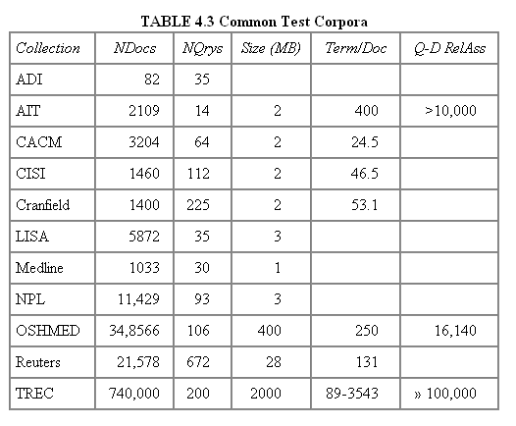
Test Collections
Notes:
careses
parties
separational -> separate
factional -> faction

Slide 43
From Document Collections to Test Collections
Still need
Test queries
Relevance assessments
Test queries
Must be carefully chosen so that they are related to document collections.
Best designed by domain experts.
Random query terms generally not a good idea.
Relevance assessments
Human judges, time-consuming
Are human panels perfect?
Notes:
careses
parties
separational -> separate
factional -> faction

Slide 44
Kappa Measure for Inter-Judge (Dis)agreement
Kappa measure
Agreement measure among judges
Designed for categorical judgments
Corrects for chance agreement
Kappa = [ P(A) – P(E) ] / [ 1 – P(E) ]
P(A) – proportion of time judges agree
P(E) – what agreement would be by chance
Kappa = 0 for chance agreement, 1 for total agreement.
Notes:
careses
parties
separational -> separate
factional -> faction

Slide 45
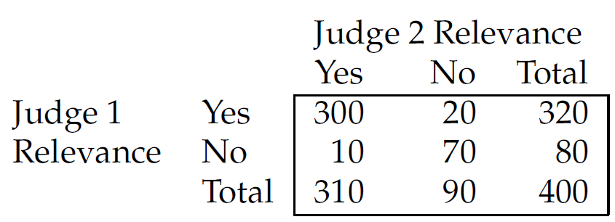
Kappa Measure: Example
Notes:
careses
parties
separational -> separate
factional -> faction

Slide 46
Kappa Measure: Example
P(A) = 370/400 = 0.925
P(nonrelevant) = (10+70+20+70)/800 = 0.2125
Regardless of judges
P(relevant) = (10+300+20+300)/800 = 0.7878
Regardless of judges
P(E) = 0.2125^2 + 0.7878^2 = 0.665
Kappa = (0.925 – 0.665)/(1-0.665) = 0.776
Kappa > 0.8 = good agreement
0.67 < Kappa < 0.8 -> “tentative conclusions”
Depends on the purpose of a study
For >2 judges: we can use an average pairwise Kappa values.
Notes:
careses
parties
separational -> separate
factional -> faction

Slide 47
Critique of Pure Relevance
Relevance vs. Marginal Relevance
Marginal relevance: what is additional, new information after looking at the previously ranked documents?
A document can be redundant even if it is highly relevant.
There could be duplicates, or the same information from different sources.
Marginal relevance is a better measure of utility for the user.
Other factors: diversity, novelty, recency, ...
Notes:
careses
parties
separational -> separate
factional -> faction

Slide 48
Can We Avoid Human Judgment?
Human judgments makes experimental work hard
Especially on a large scale
In some very specific settings, can use proxies
Implicit relevance judgments for web search: clicks
Notes:
careses
parties
separational -> separate
factional -> faction

Slide 49
A/B Testing
Purpose: Test a single innovation
Prerequisite: You have a large search engine up and running.
Have most users use old system
Divert a small proportion of traffic (e.g., 1%) to the new system that includes the innovation.
Evaluate with an “automatic” measure like clickthrough on first result.
Now we can directly see if the innovation does improve user happiness.
Probably the evaluation methodology that large search engines trust most.
In principle, less powerful than doing a multivariate regression analysis, but easier to understand.
Microsoft example: http://www.exp-platform.com/Pages/KDD2015KeynoteExPKohavi.aspx
Notes:
careses
parties
separational -> separate
factional -> faction

Slide 50
Further Reading
IIR book, Chapter 8
Notes:
Can be viewed as a table.

